Slide 1
TEAM-38
Detection of Distributed Denial of Service Attacks in SDN using Machine Learning Techniques
Presented by:
Shwetha A - 2019105576
Harini V - 2019105013
Yamini K - 2019105605
Jayaashree P - 2019105541
Project guide:
Dr. Manimekalai T

Slide 2
OBJECTIVE
To detect the attack in the SDN network using appropriate ML techniques and then blocking the port where the host is attacked and making the destination host unreachable as part of the mitigation.

Slide 3
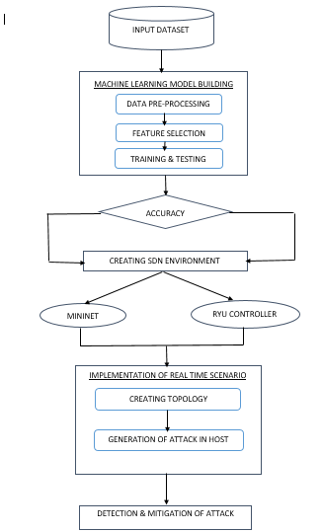
FLOW OF PROJECT WORK

Slide 4
ACCURACY PROVIDED BY DIFFERENT ML ALGORITHMS
DECISION TREE | Success Accuracy = 99.97 %
LOGISTIC REGRESSION | Success Accuracy = 94.42 %
KNN | Success Accuracy = 99.72 %
RANDOM FOREST | Success Accuracy = 100 %
NAIVE BAYES | Success Accuracy = 80.79 %

Slide 5
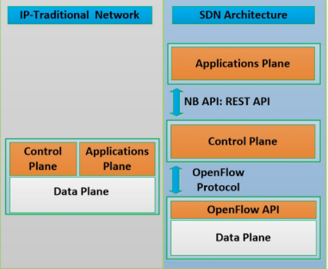
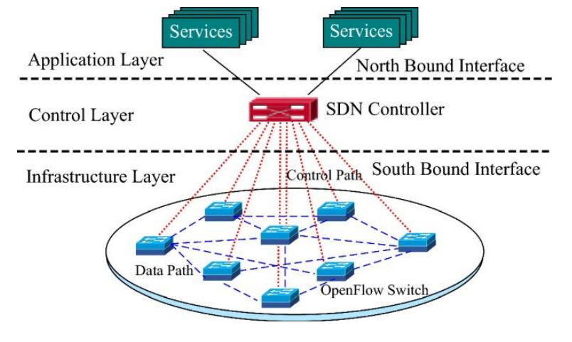
Traditional vs SDN Architecture

Slide 6
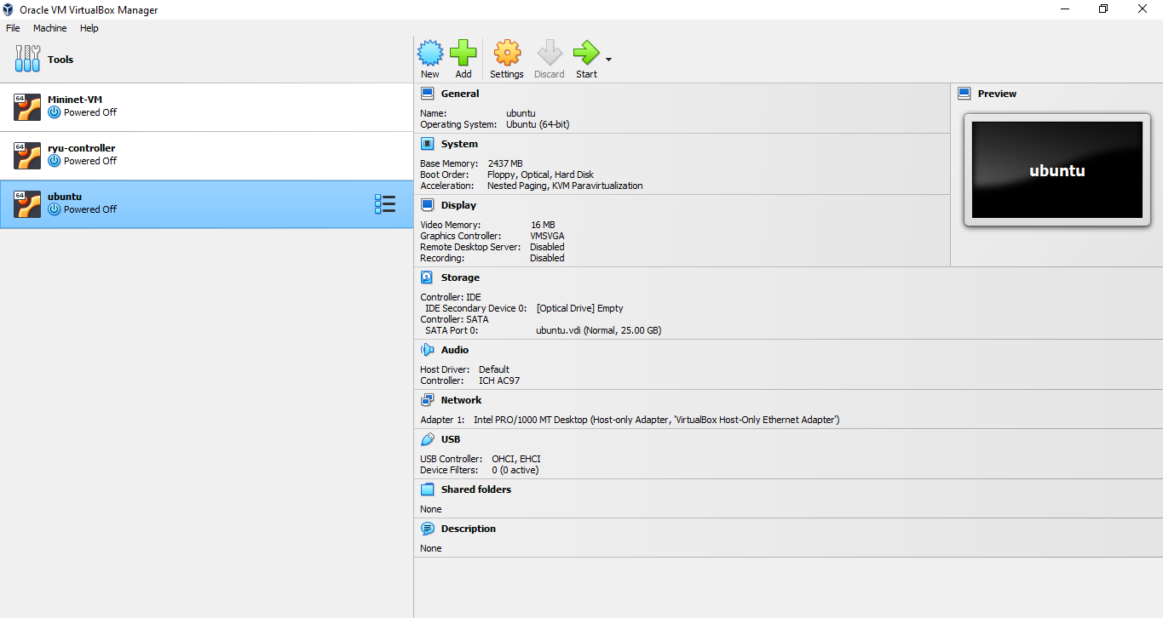
EXPERIMENTAL SETUP REQUIREMENT
SIMULATION SOFTWARE
MININET
RYU CONTROLLER
OPERATING SYSTEM
UBUNTU
PLATFORM
VIRTUALBOX
MOBAXTERM SERVER

Slide 7
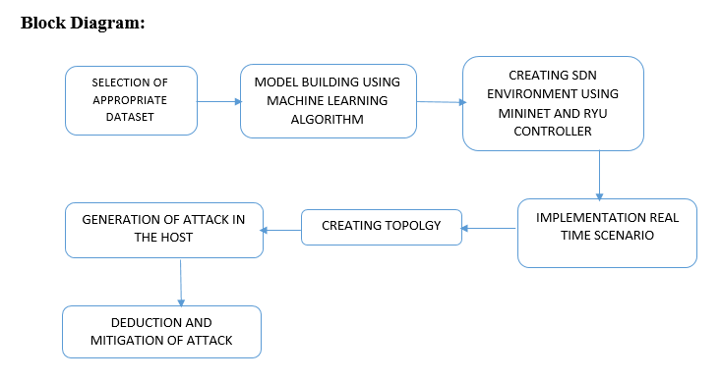

Slide 8
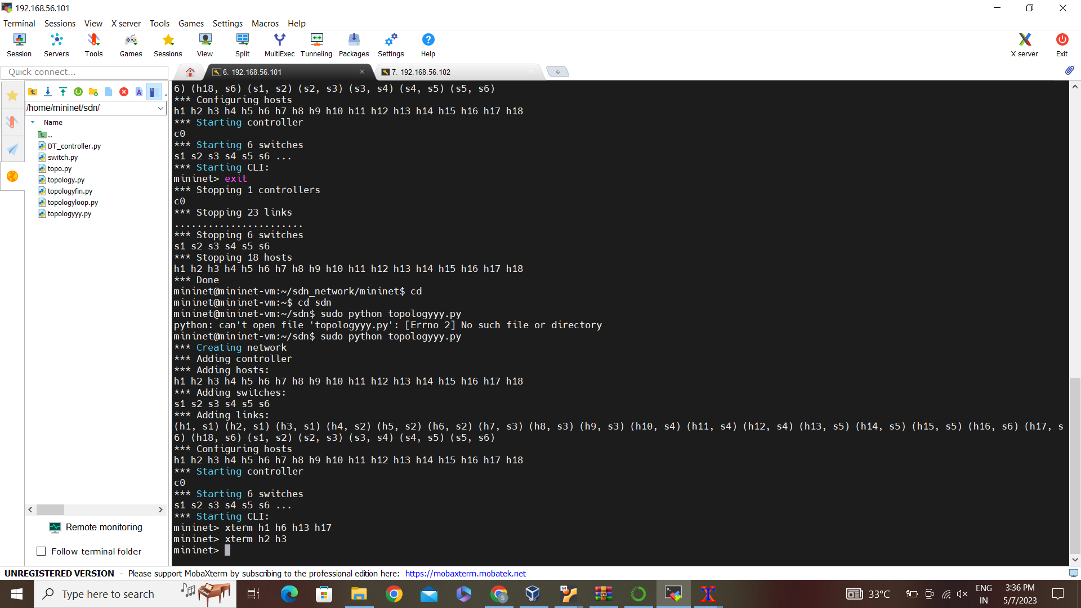
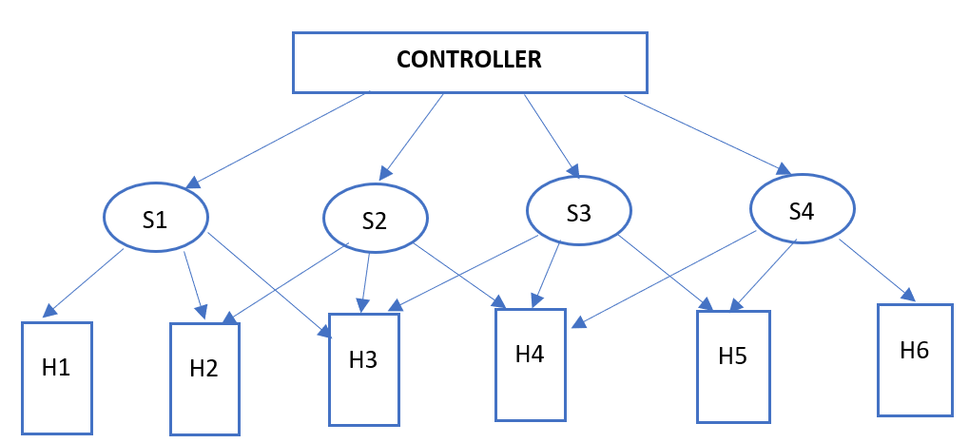
MININET
Topology Creation :

Slide 9
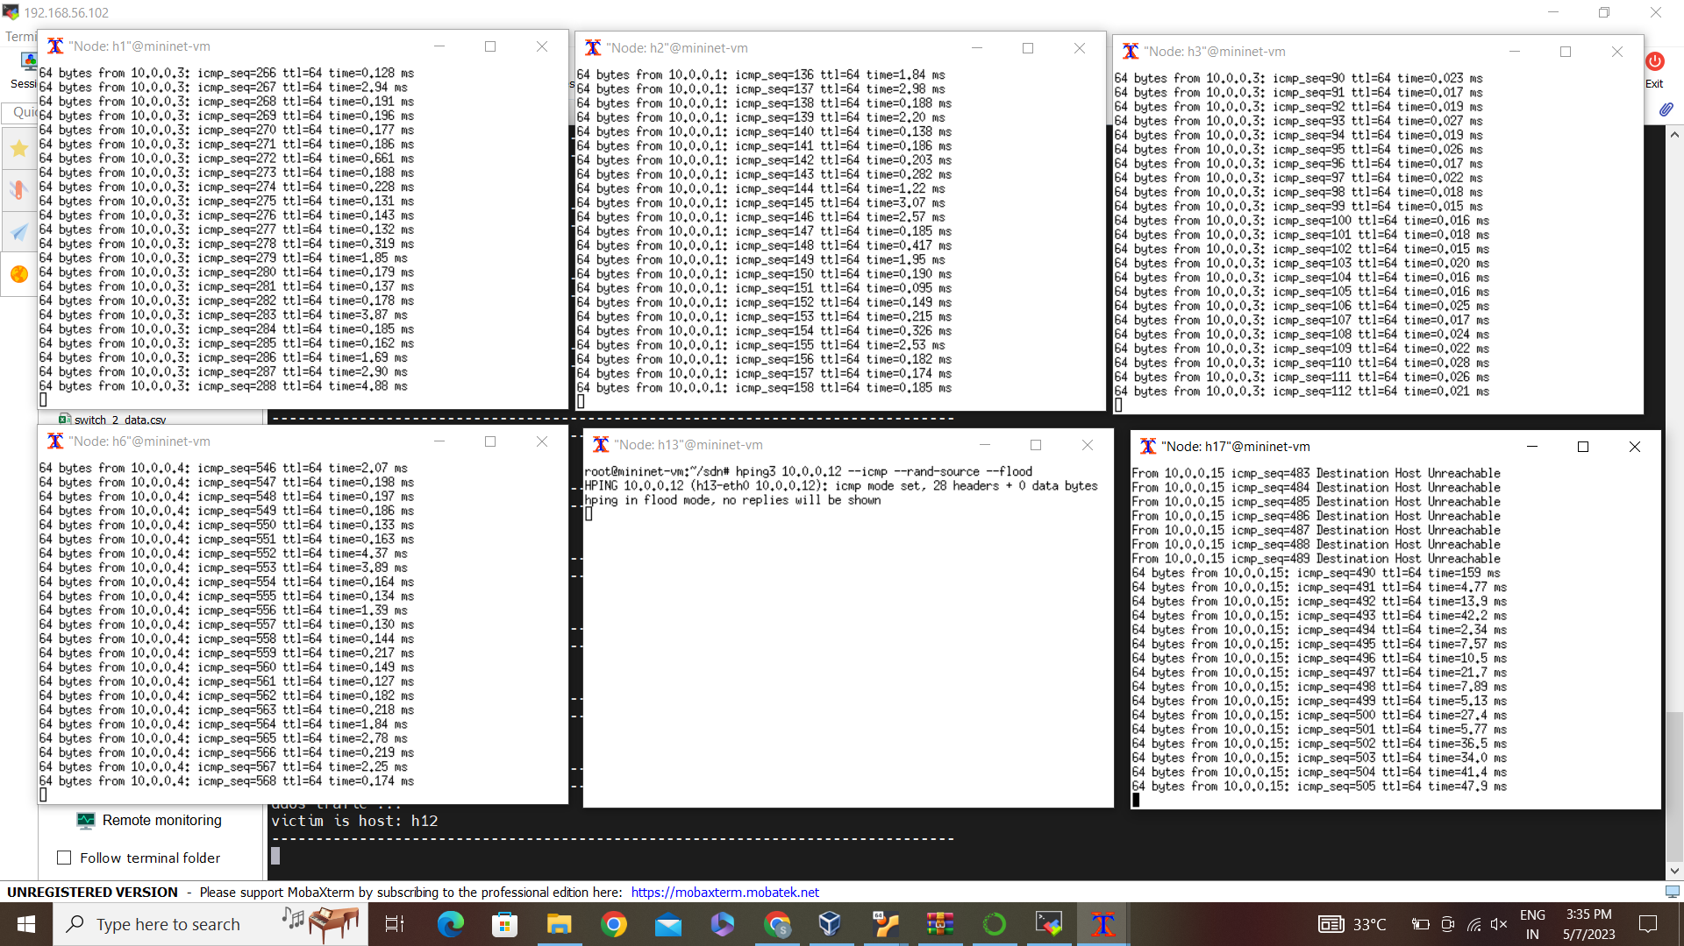
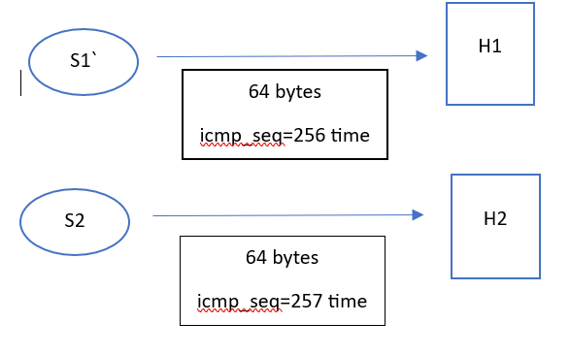
Real time Scenario:

Slide 10
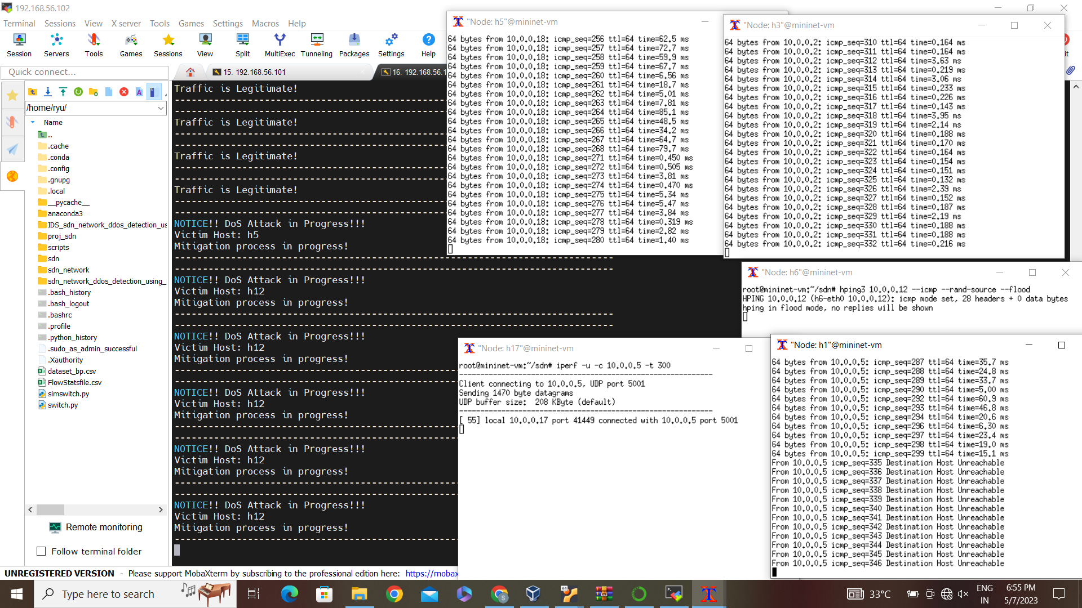
Detection and Mitigation:

Slide 11
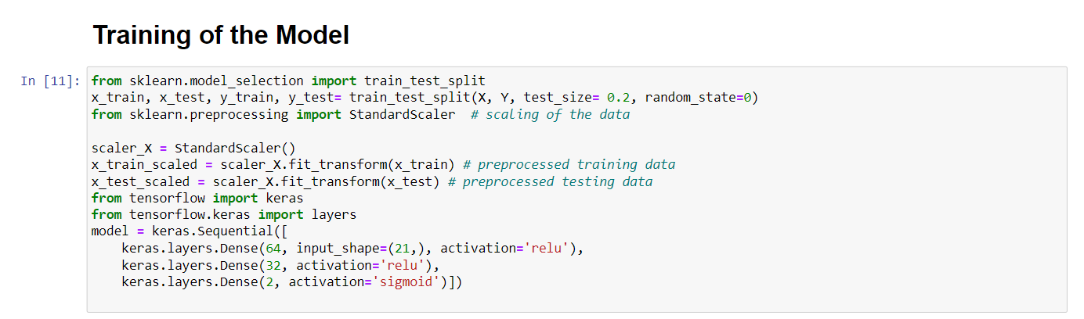
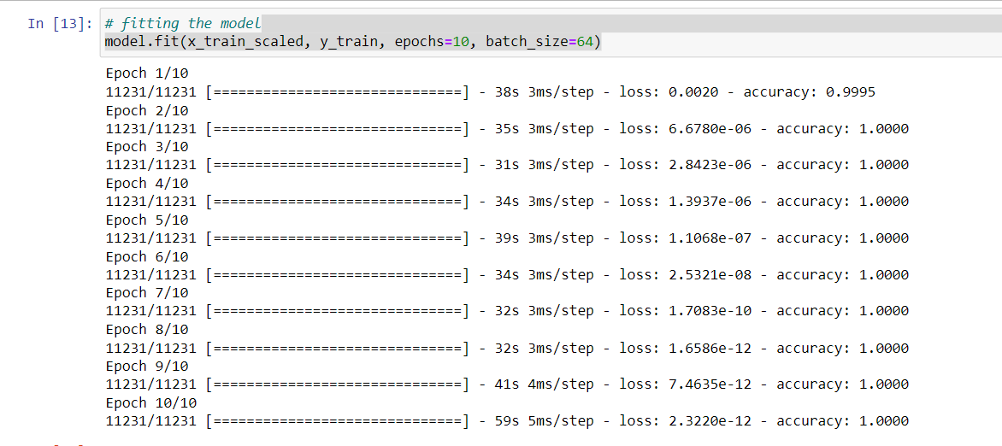
DEEP LEARNING APPROACH:
ANN

Slide 12
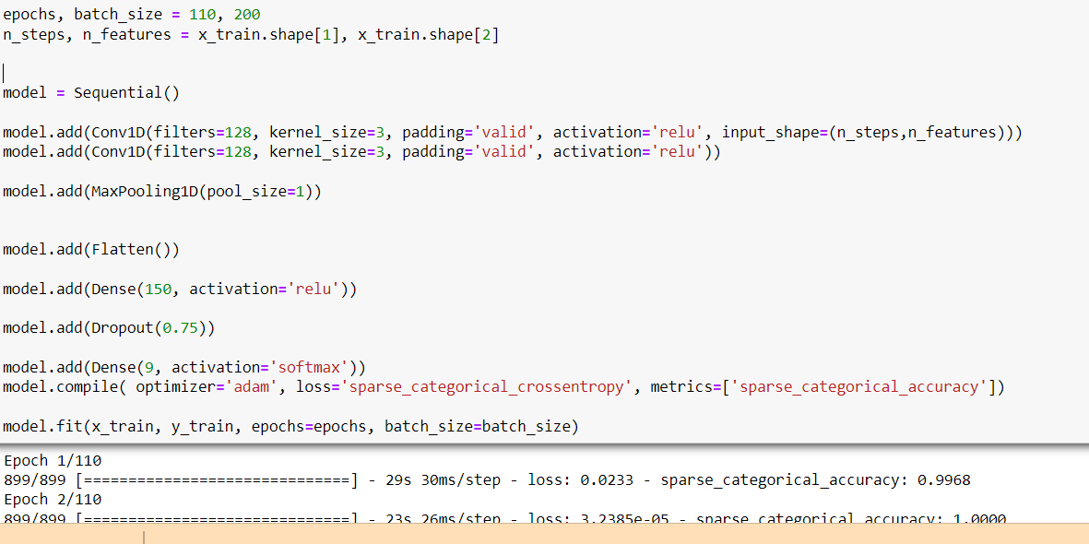
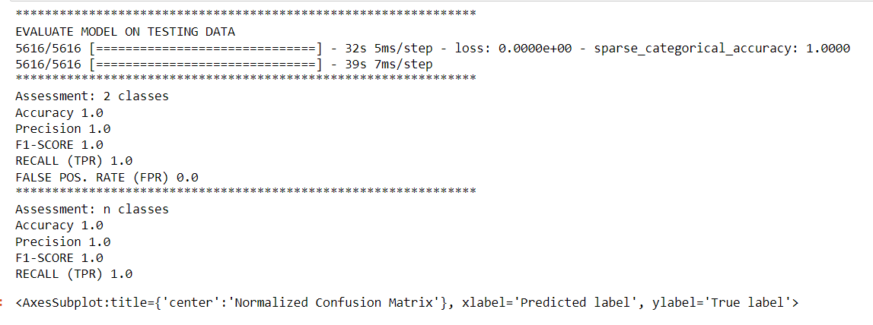
CNN

Slide 13
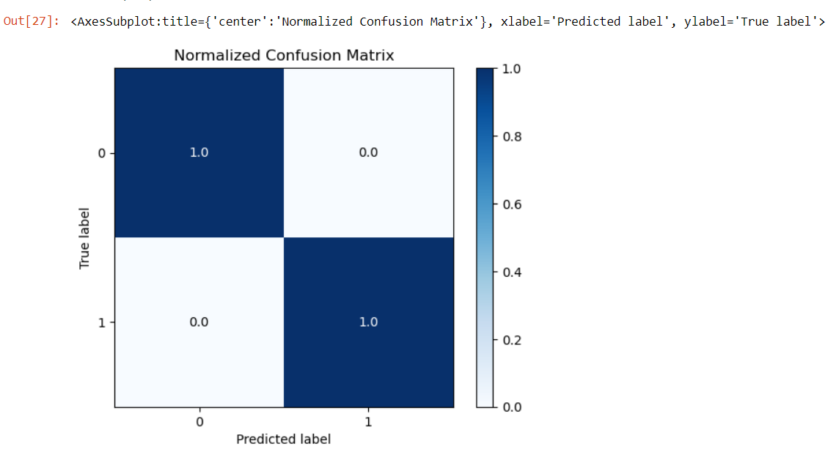
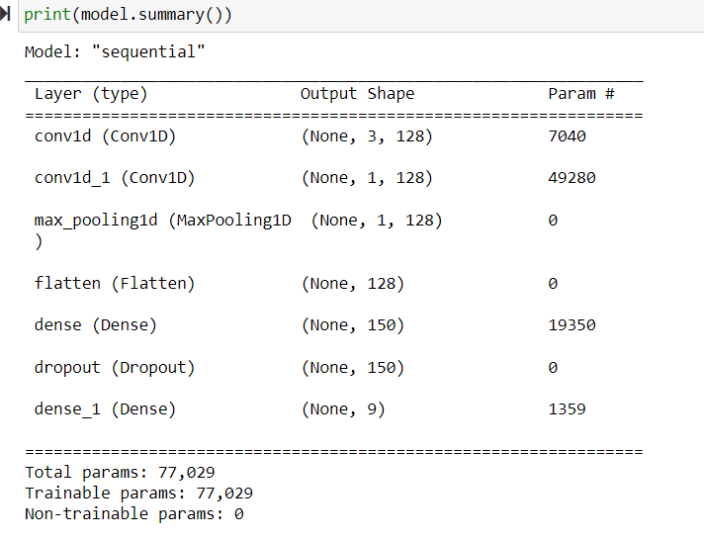

Slide 14
PARAMETERS | ANN | CNN
EPOCHS | 10 | 110
ACCURACY
AVERAGE TIME TAKEN | 45 s | 29 s
EPOCH 1 | 99.95 % | EPOCH 1 | 99.68 %
EPOCH 10 | 100 % | EPOCH 10 | 100 %

Slide 15
MACHINE LEARNING VS DEEP LEARNING:
 | MACHINE LEARNING | DEEP LEARNING
PRECISION | 0.995 | 1.0
F-SCORE | 0.996 | 1.0
RECALL | 0.998 | 1.0
ACCURACY | 0.9972 | 1.0

Slide 16
CONCLUSIONS
Accuracy of the Machine learning and deep learning algorithms have been compared with the base paper and the results have been successfully replicated.
The attack is detected in the SDN network using appropriate ML techniques and then the port where the host is attacked is blocked and the destination host is made unreachable as part of the mitigation.

Slide 17
REFERENCES
1.Ahmad, I., Namal, S., Ylianttila, M. and Gurtov, A. (2015). Security in software defined networks: A survey, IEEE Communications Surveys Tutorials 17(4): 2317–2346. JCR Impact Factor: 22.973 (2019). Alshamrani, A., Chowdhary, A., Pisharody, S., Lu, D. and 2.Huang, D. (2017). A defense system for defeating ddos attacks in sdn based networks, Proceedings of the 15th ACM International Symposium on Mobility Management and Wireless Access, MobiWac ’17, Association for Computing Machinery, New York, NY, USA, p. 83–92. ERA Ranking: B.
2.M. S. E. Sayed, N. -A. Le-Khac, M. A. Azer and A. D. Jurcut, "A Flow-Based Anomaly Detection Approach With Feature Selection Method Against DDoS Attacks in SDNs," in IEEE Transactions on Cognitive Communications and Networking, vol. 8, no. 4, pp. 1862-1880, Dec. 2022

